Slide 1

Visual DESIGN DECK
August 9, 2017

Slide 2
Concept Art

Slide 3



Figure Design
Basic proportion & bikini designs
0xffc395
0xffc395
Female: Bikini
Male: Speedo
*Backside:
Please look at how hair goes down on the back & shoulder
Male: basically wears a speedo/ but could have a tank top depending on the character/ photo reference
Female: basically wears a bikini/ but could have a monokini/tank top depending on the character/ photo reference
* No sleeves and shoes

Slide 4


Figure Design
Censored

Slide 5


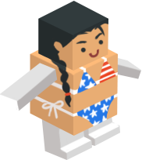
Figure Design
Dimensions
Replaceable part
Height: 107 px
Hex values
Width: 93 px
Flat front and back
Equal head size & face proportion
Equal leg & arm lengths
Hex values in red: multiply over grayscale legs & arms in spritesheets
Proportion exceptions: marked with purple stars
Proportion could be changed when a certain part of body significantly stands out
Do not exceed the widest(stretched arm) & highest(top of head) points
Do not change heights of head and body
Width can be adjusted depending on characteristics
Please check the psd file to see progress & layers

Slide 6



Figure Design
Spritesheet breakdown
Leg/Arm spritesheet setting:
Scale 0.5
1024 x 1024
None trim
Export head attached on body
Use arm/leg sprites for all bodies

Slide 7
Asset Storage
Link
Json Spreadsheet: display name, file name and hex value
https://docs.google.com/spreadsheets/d/1pkuDdwKRnd4O0wjpIKlsqKwcD1ZtrYAxPtWBm5tHryw/edit#gid=0
Spritesheet
https://drive.google.com/drive/folders/0BymUgcUWXfeuekpwMnFDV3ZNUXc
Png
https://drive.google.com/drive/folders/0BymUgcUWXfeuZlRxaXI1dFdYd28
Psd
https://drive.google.com/drive/folders/0BymUgcUWXfeuY0FETUVDOGk2Y2M

Slide 8







Figure Design
Design categories
Political figure
Halloween
(holiday)
Primitive

Slide 9







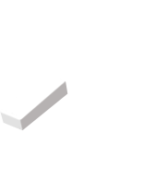
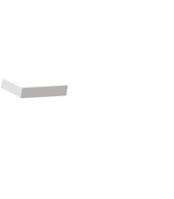
Figure Design
Design categories
Do not exceed the highest point
Do not exceed the widest point
Occupation
Celebrity

Slide 10










Figure Design
Bikini variations
Bikini
Monokini

Slide 11








Figure Design
Speedo variations
Speedo
Costume style

Slide 12
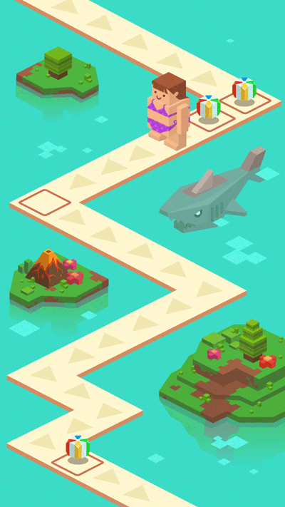
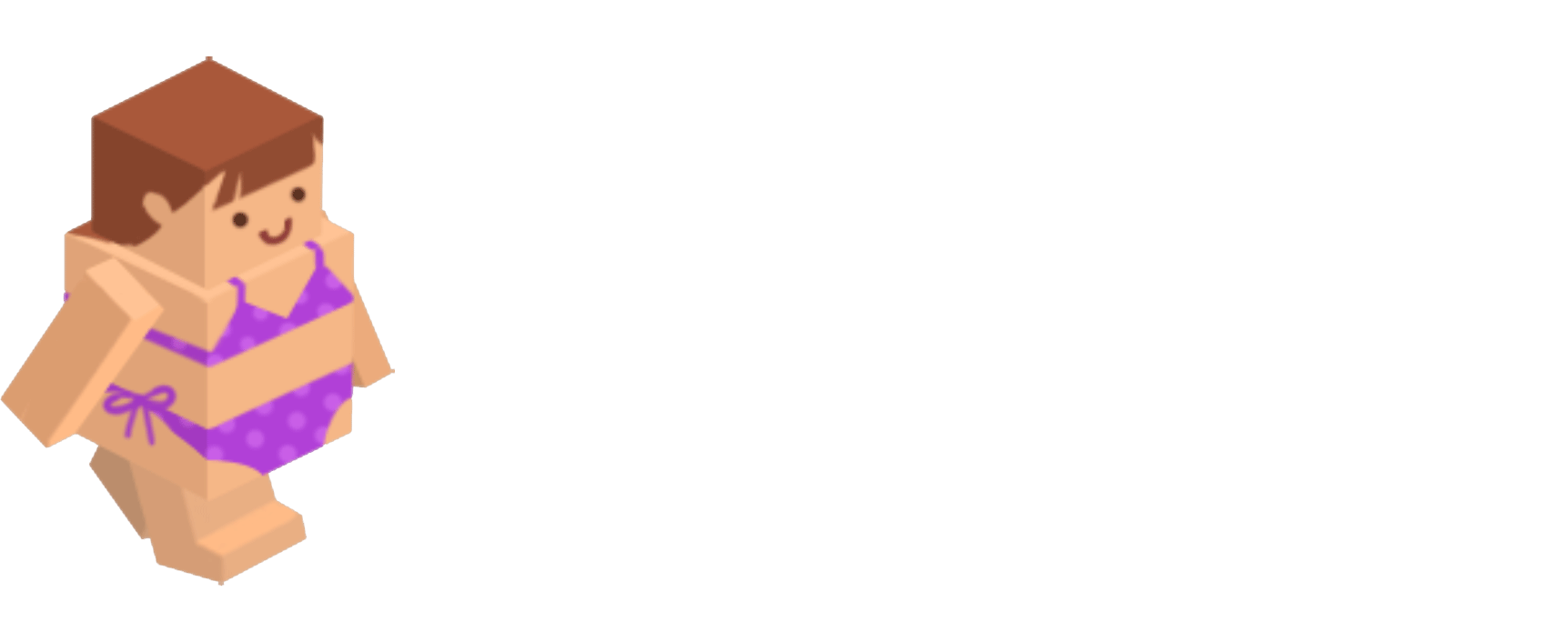
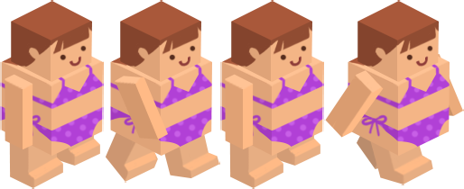
Figure Design
Walking sprite sheet
Run ref: https://www.youtube.com/watch?v=XW2KcCl1tu8

Slide 13
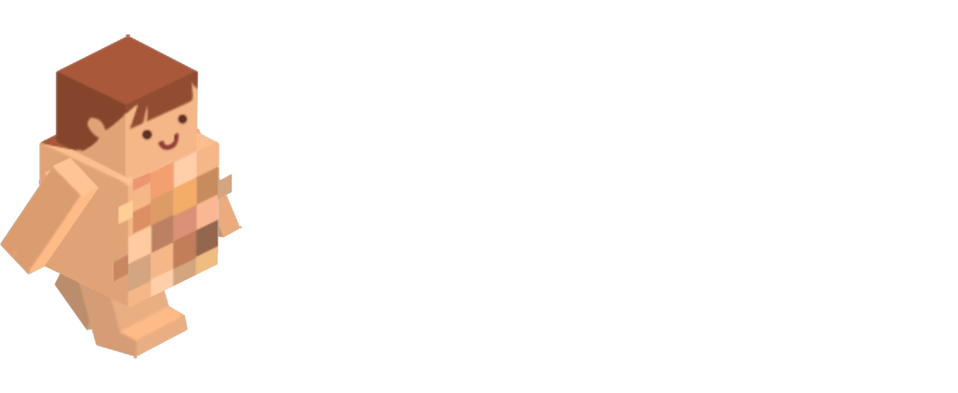
Figure Design
Walking sprite sheet
Run ref: https://www.youtube.com/watch?v=XW2KcCl1tu8

Slide 14
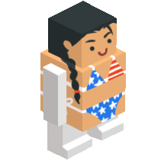
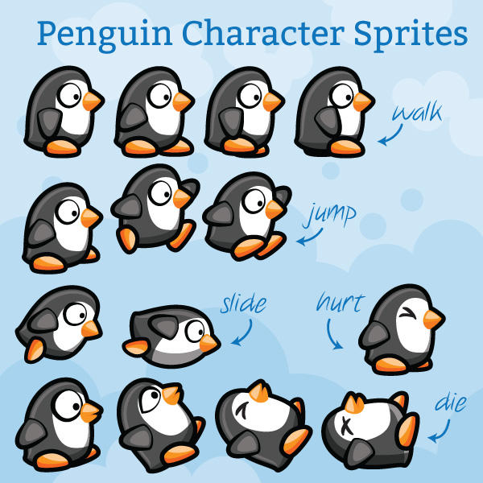
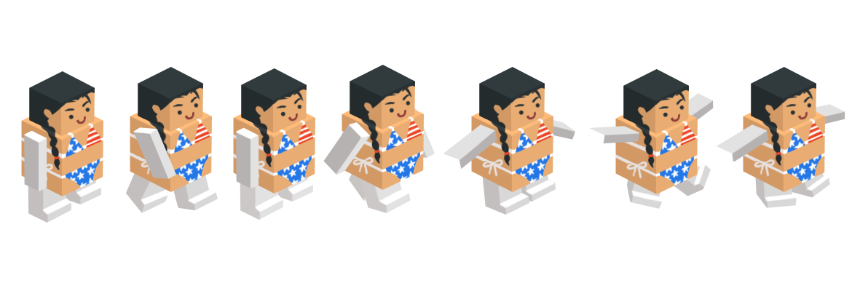
Figure Design
Jump sprite sheet
Walking cycle
Jumping

Slide 15
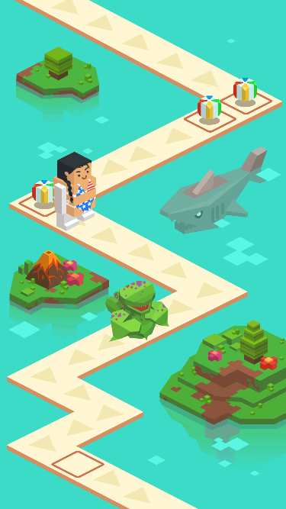

Figure Design
Jumping spritesheet

Slide 16

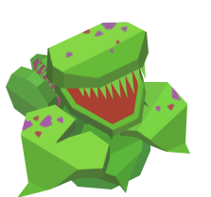
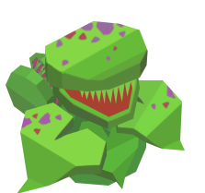
Sprite Sheet Flow
Goomba: Fly trap
Jumping from frame 8
Multiply hex values
Over legs
1. Catching cycle
Static cycle: repeat frame 1 to 4
Repeat x1
frame 11 to 14
2. Idle cycle
Static cycle: repeat frame 1 to 4
Go back to frame 7 to 6
Go back to frame 1 and repeat static cycle
Frame 1 to 9

Slide 17
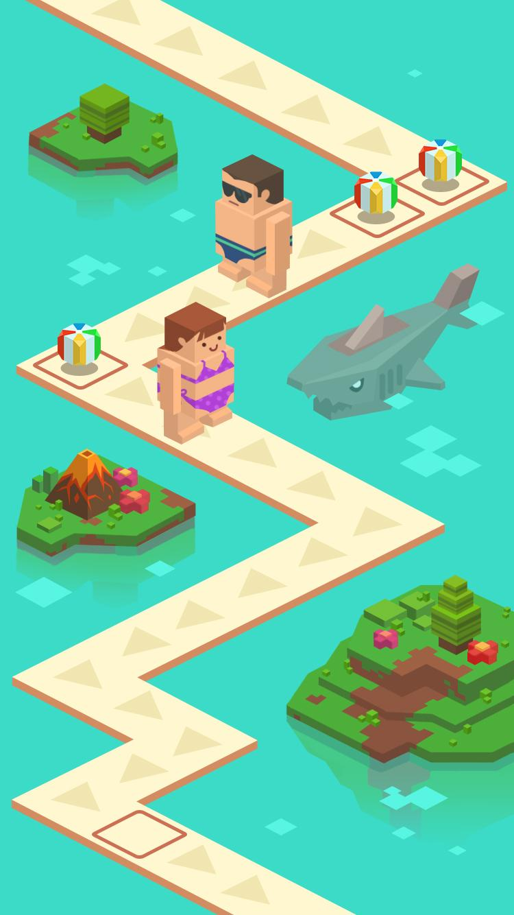


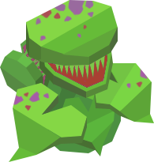
Background Design
Basic assets
Hex value:
0x3cdbc7
Island
Currency tile
Shark
Basic tile
Water reflection
Obstacles

Slide 18








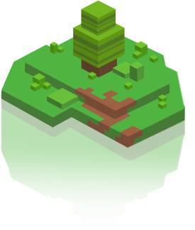
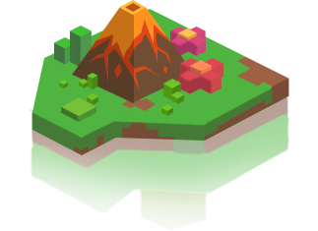
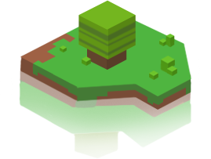
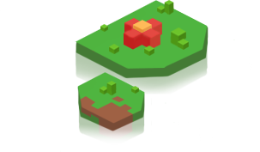
Background Design
Decorative elements
Currency (volley ball)
Water reflection variations
Tile
(basic)
Tile
(currency/
item)
Shadow:
0x3e301b, 40%
Island variations

Slide 19
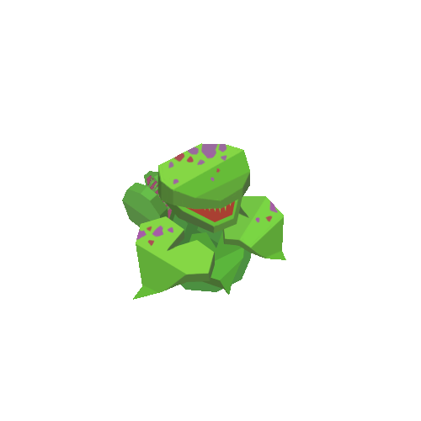

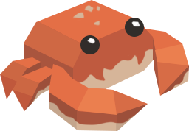


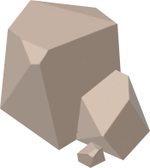

Background Design
Obstacles
Goomba
Crab
Fly trap
Inactive Active
Walls: static
Sand castle
Surfboard
Pipe
Rock
(1 tile)
2 Rocks
(2 tile)

Slide 20

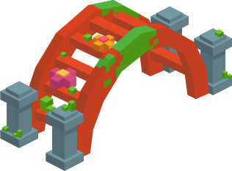
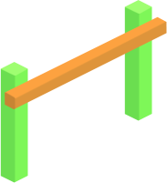


Background Design
Obstacles
Rolling
Rock
Tumbleweed
Slide under
Bridge
Surf board
Limbo bar

Slide 21
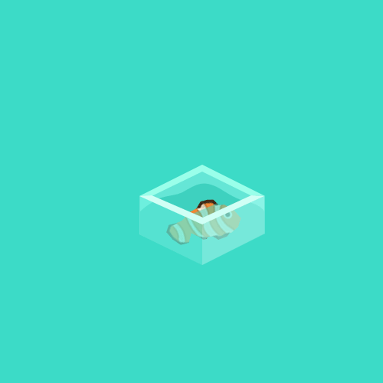


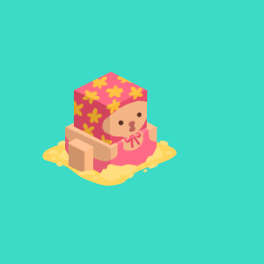


Background Design
Obstacles
Jumping over
Fish out of water
Inactive Active
Walls: dynamic intervals
Kid shooting water
Inactive Active

Slide 22
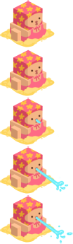


Sprite sheet breakdown
Obstacles
Static cycle
Shooting cycle
Static cycle
Jumping cycle

Slide 23
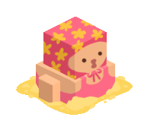
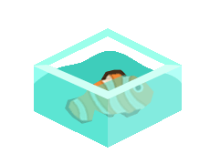


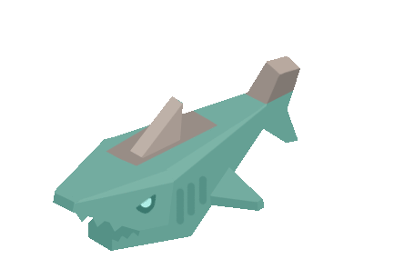
Obstacle Animation
GIF

Slide 24
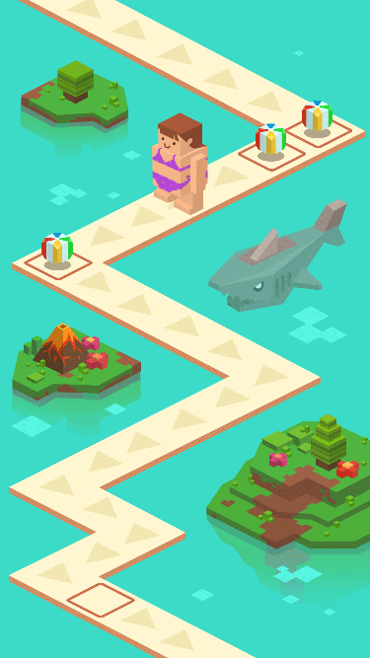



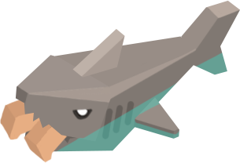
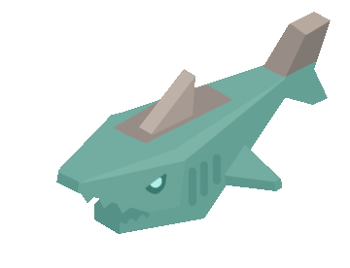
Character Design
Shark
Shark under the water
Shark eating
(when character falls down)
Shark
Inactive
Active

Slide 25
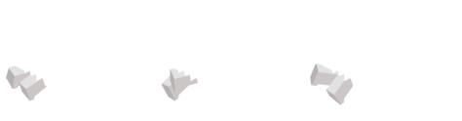
Sprite sheet breakdown
Shark
Static cycle: repeat frame 1 to 4
Eating cycle frame 5 to 11
1. Multiply hex values
Over legs
2. Repeat x2 frame 9 to 11

Slide 26
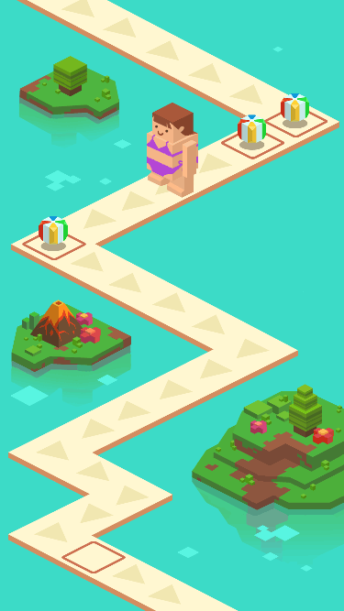


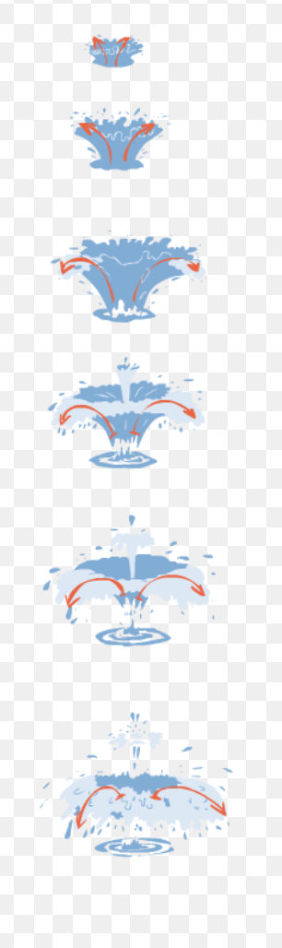
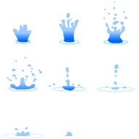

VFX
Waterdrop
VFX for defeat/kill
Water splash for objects falling in water

Slide 27
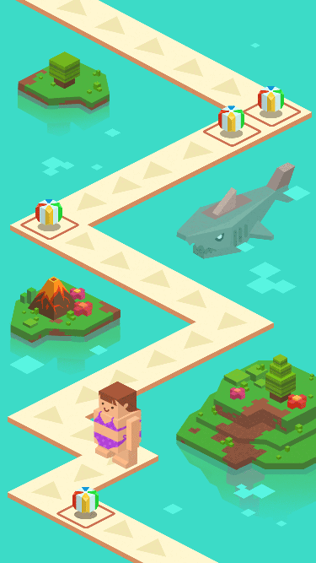


VFX
Blink

Slide 28

VFX
Transforming effect

Slide 29
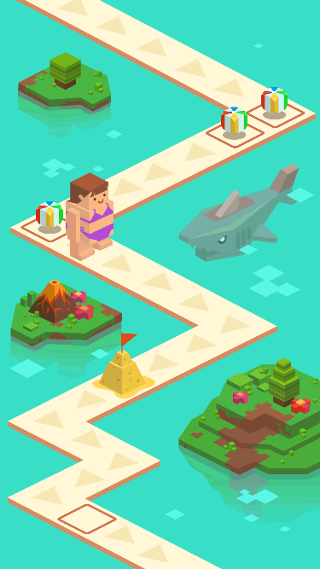
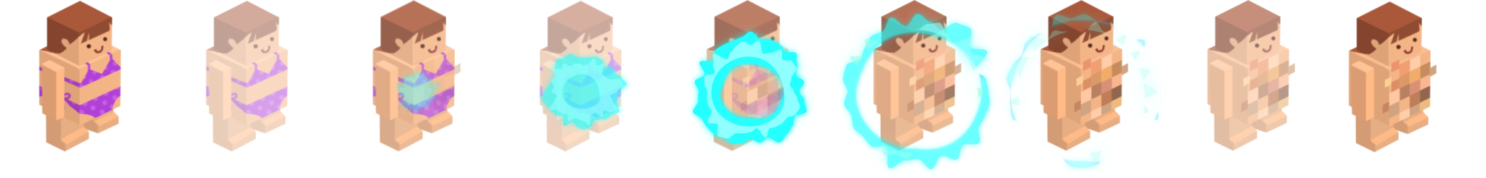
VFX
Transforming effect
Full HP
-50% HP
Hit the obstacle
0%
40%
70%
100%
60%
100%
100%
50%
70%
35%
10%
0%
VFX

Slide 30
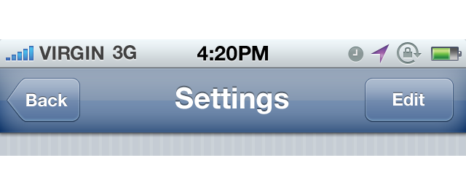




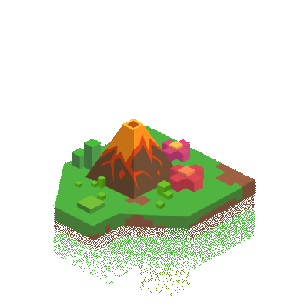


Scale comparison

Slide 31
UI/UX

Slide 32
UI
Typography
Headline and CTAs:
Aa
Luckiest Guy
​‌A​‌B​‌C​‌Ć​‌Č​‌D​‌Đ​‌E​‌F​‌G​‌H​‌I​‌J​‌K​‌L​‌M​‌N​‌O​‌P​‌Q​‌R​‌S​‌Š​‌T​‌U​‌V​‌W​‌X​‌Y​‌Z​‌Ž​‌a​‌b​‌c​‌č​‌ć​‌d​‌đ​‌e​‌f​‌g​‌h​‌i​‌j​‌k​‌l​‌m​‌n​‌o​‌p​‌q​‌r​‌s​‌š​‌t​‌u​‌v​‌w​‌x​‌y​‌z​‌ž​‌А​‌Б​‌В​‌Г​‌Д​‌Е​‌Ё​‌Ж​‌З​‌И​‌Й​‌К​‌Л​‌М​‌Н​‌О​‌П​‌Р​‌С​‌Т​‌У​‌Ф​‌Х​‌Ц​‌Ч​‌Ш​‌Щ​‌Ъ​‌Ы​‌Ь​‌Э​‌Ю​‌Я​‌а​‌б​‌в​‌г​‌д​‌е​‌ё​‌ж​‌з​‌и​‌й​‌к​‌л​‌м​‌н​‌о​‌п​‌р​‌с​‌т​‌у​‌ф​‌х​‌ц​‌ч​‌ш​‌щ​‌ъ​‌ы​‌ь​‌э​‌ю​‌я​‌Ă​‌Â​‌Ê​‌Ô​‌Ơ​‌Ư​‌ă​‌â​‌ê​‌ô​‌ơ​‌ư​‌1​‌2​‌3​‌4​‌5​‌6​‌7​‌8​‌9​‌0​‌‘​‌?​‌’​‌“​‌!​‌”​‌(​‌%​‌)​‌[​‌#​‌]​‌{​‌@​‌}​‌/​‌&​‌<​‌-​‌+​‌÷​‌×​‌=​‌>​‌®​‌©​‌$​‌€​‌£​‌¥​‌¢​‌:​‌;​‌,​‌.​‌
REgular
Styles Used:
Body texts:
Aa
Open Sans
​‌A​‌B​‌C​‌Ć​‌Č​‌D​‌Đ​‌E​‌F​‌G​‌H​‌I​‌J​‌K​‌L​‌M​‌N​‌O​‌P​‌Q​‌R​‌S​‌Š​‌T​‌U​‌V​‌W​‌X​‌Y​‌Z​‌Ž​‌a​‌b​‌c​‌č​‌ć​‌d​‌đ​‌e​‌f​‌g​‌h​‌i​‌j​‌k​‌l​‌m​‌n​‌o​‌p​‌q​‌r​‌s​‌š​‌t​‌u​‌v​‌w​‌x​‌y​‌z​‌ž​‌А​‌Б​‌В​‌Г​‌Д​‌Е​‌Ё​‌Ж​‌З​‌И​‌Й​‌К​‌Л​‌М​‌Н​‌О​‌П​‌Р​‌С​‌Т​‌У​‌Ф​‌Х​‌Ц​‌Ч​‌Ш​‌Щ​‌Ъ​‌Ы​‌Ь​‌Э​‌Ю​‌Я​‌а​‌б​‌в​‌г​‌д​‌е​‌ё​‌ж​‌з​‌и​‌й​‌к​‌л​‌м​‌н​‌о​‌п​‌р​‌с​‌т​‌у​‌ф​‌х​‌ц​‌ч​‌ш​‌щ​‌ъ​‌ы​‌ь​‌э​‌ю​‌я​‌Ă​‌Â​‌Ê​‌Ô​‌Ơ​‌Ư​‌ă​‌â​‌ê​‌ô​‌ơ​‌ư​‌1​‌2​‌3​‌4​‌5​‌6​‌7​‌8​‌9​‌0​‌‘​‌?​‌’​‌“​‌!​‌”​‌(​‌%​‌)​‌[​‌#​‌]​‌{​‌@​‌}​‌/​‌&​‌<​‌-​‌+​‌÷​‌×​‌=​‌>​‌®​‌©​‌$​‌€​‌£​‌¥​‌¢​‌:​‌;​‌,​‌.​‌
Regular Bold
Styles Used:

Slide 33
UI
GAME LOGO

Slide 34
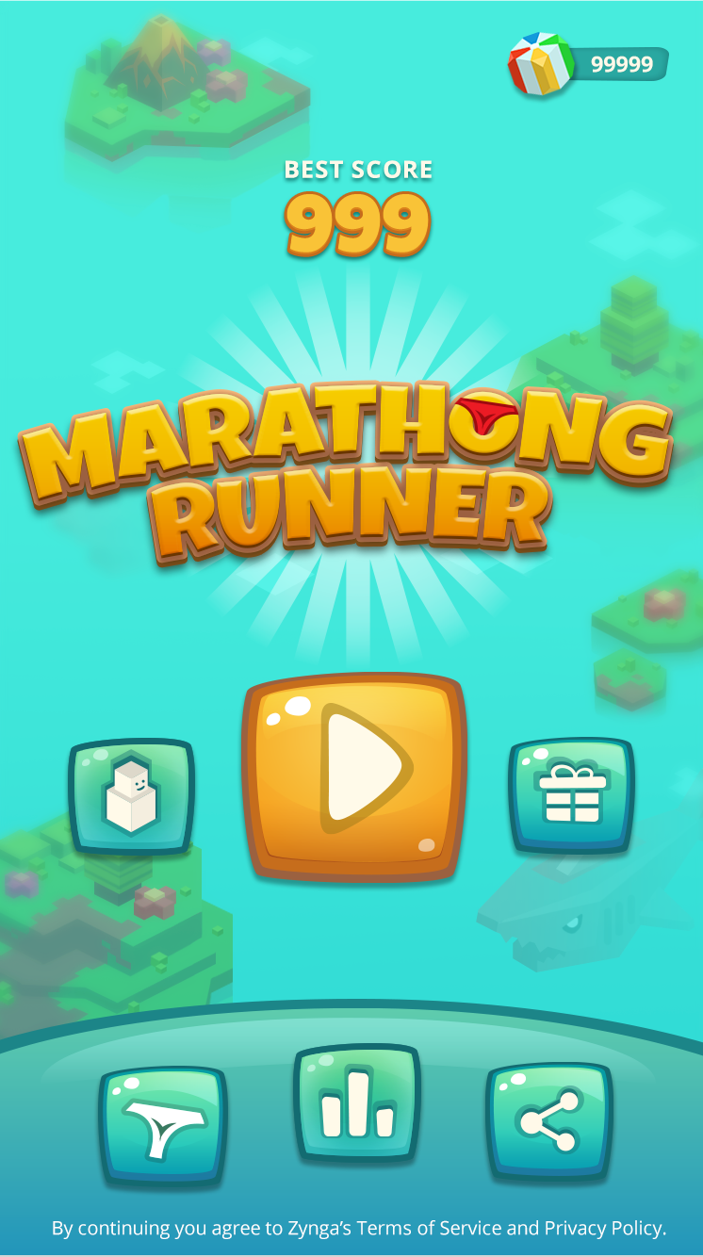
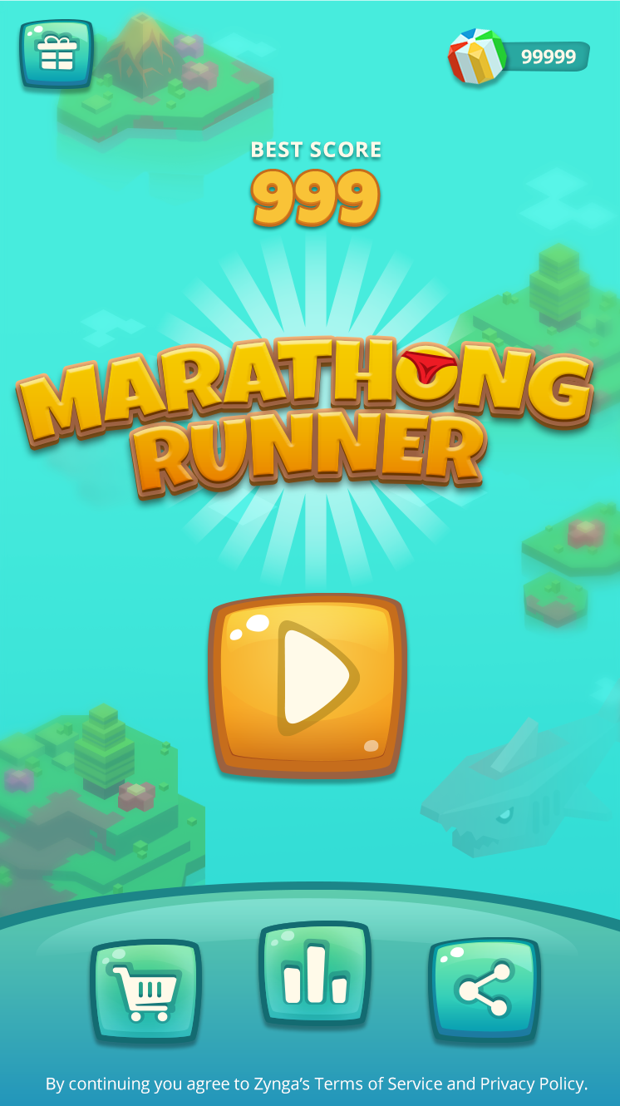

UI
Main Page

Slide 35
UI
Main Page
Wallet
Font: Open Sans Bold, 23px, fff9e9.
Score:
Text:
Font: Open Sans Bold, 25px, #fff9e9.
Drop Shadow: Multiply, 32%, distance 3px,
size 3px, #000000.
Number:
Font: Luckiest Guy, 90px, #f8c238.
Stroke: 3px, #9b6040
Drop Shadow: Multiply, 32%, distance 4px, size 5px, #000000.
Button:
Drop Shadow: Multiply, 32%, distance 5px, size 6px, #000000.
Privacy Policy Warning
Font: Open Sans Regular, 22px, #ffffff
Please make a Link to Zynga Privacy Policy

Slide 36
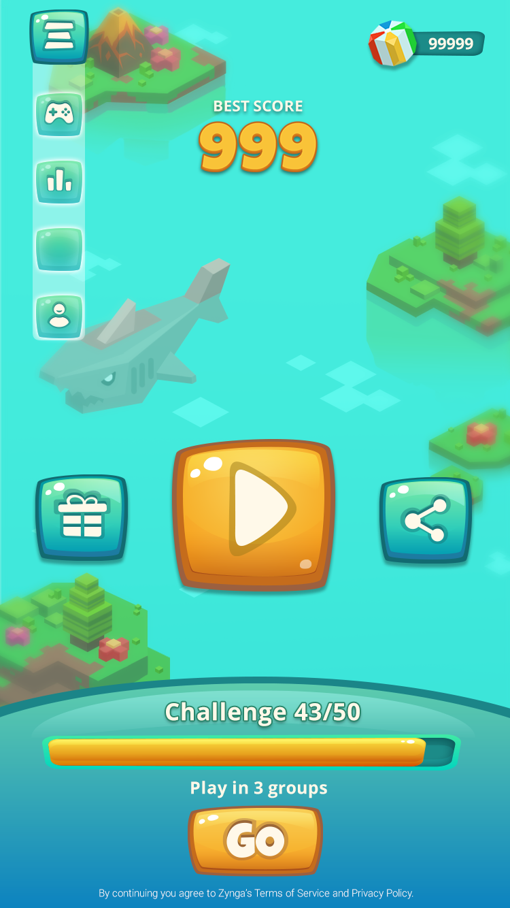
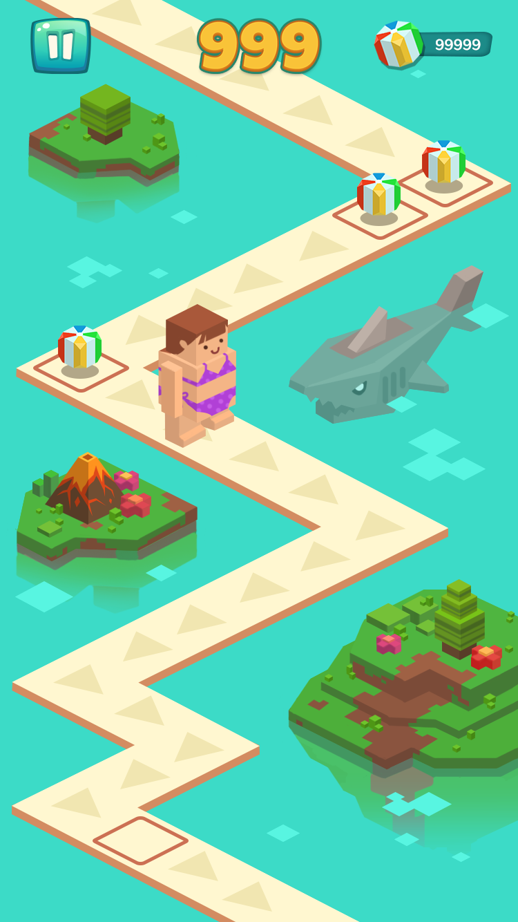

UI
Game Page
Button(Pause):
Drop Shadow: Multiply, 32%, distance 5px, size 6px, #000000.
Wallet
Font: Open Sans Bold, 23px, fff9e9.
Score:
Font: Luckiest Guy, 90px, #f8c238.
Stroke: 3px, #106464
Drop Shadow: Multiply, 32%, distance 4px, size 5px, #000000.

Slide 37
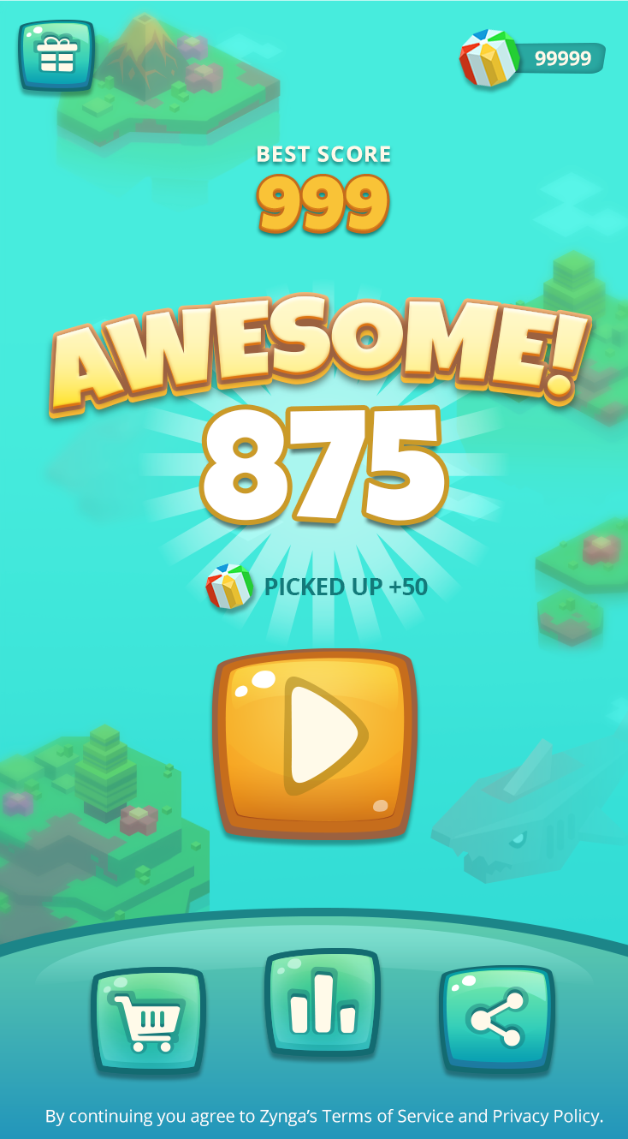
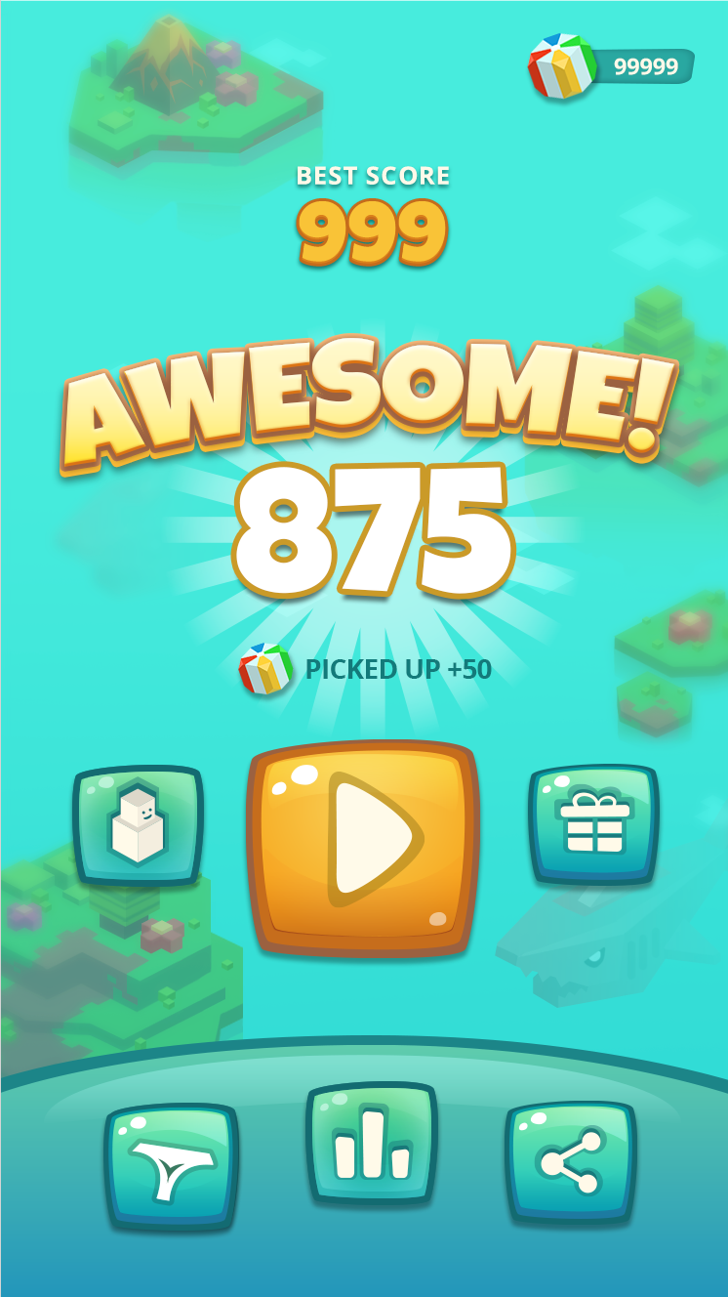
Results Screen

Slide 38






UI
Game Page
Home:
Pause:
Long CTA:
Inactive
Active

Slide 39










UI
Main Page buttons
Play (GO):
Play:
Share:
Bikini Shop:
Leaderboard:
Daily Drip:

Slide 40

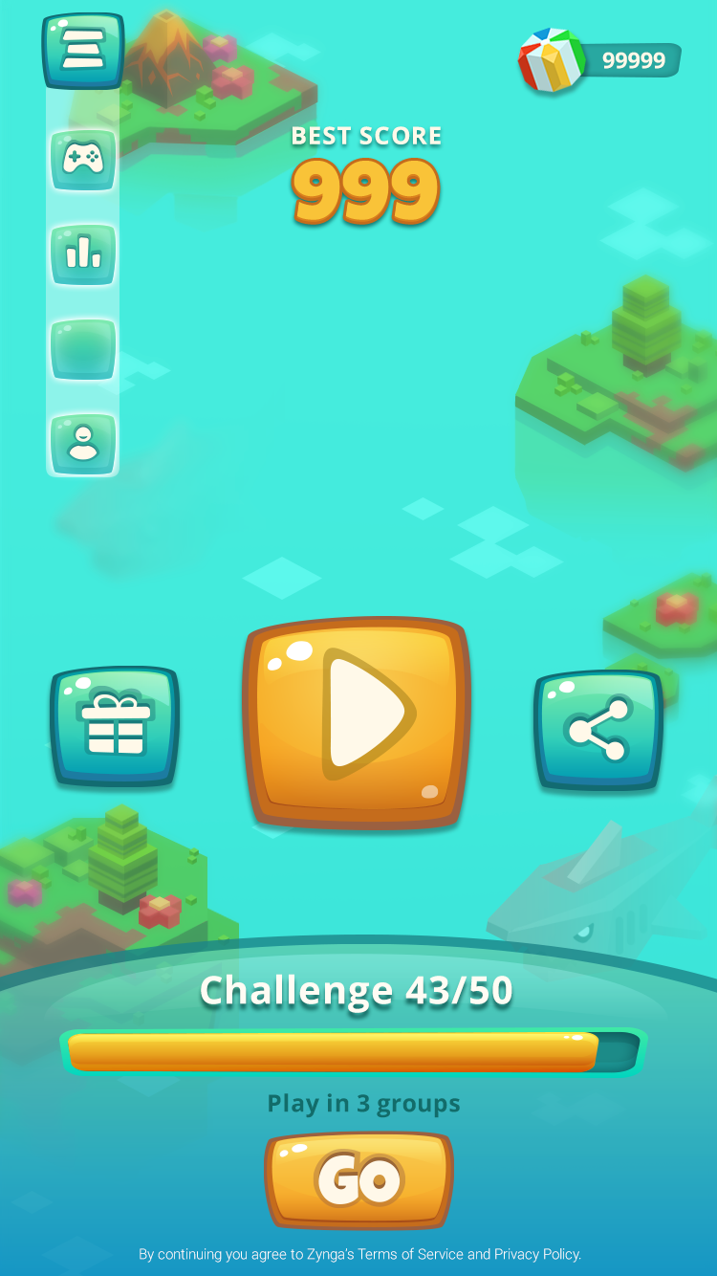
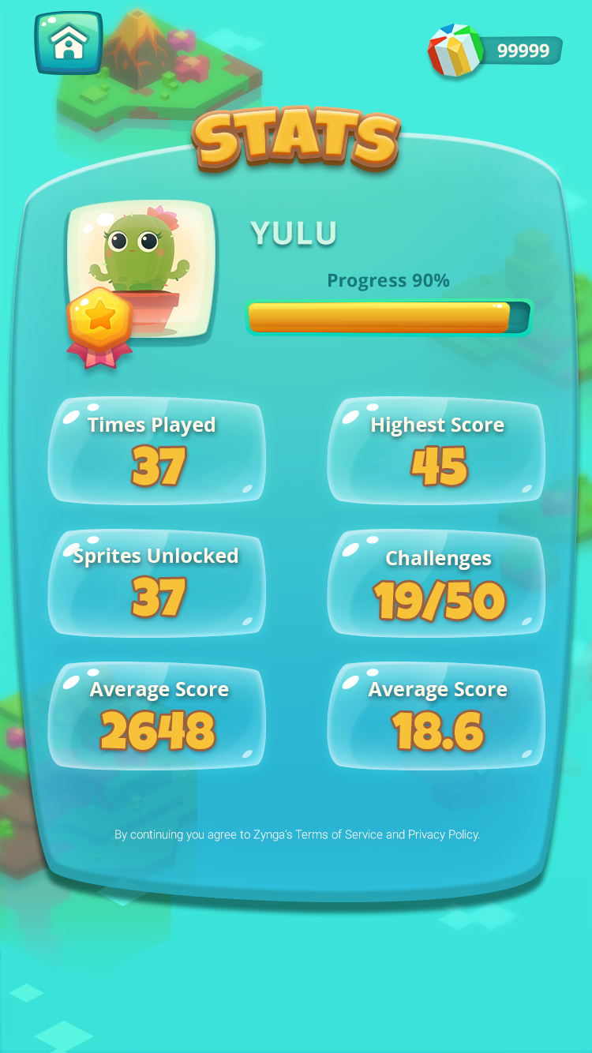




UI
Daily reward Page

Slide 41
UI
Daily reward Page
Darken layer:
Multiply, opacity 100%, #495c62
Darken layer:
Opacity 50%, #14768a.
Days:
Font: Luckiest Guy, 50px, #f8c238.
Stroke: 3px, #9b6040
Drop Shadow: Multiply, 32%, distance 4px, size 5px, #000000.
Body text and numbers:
Font: Open Sans Bold, 50px, #ffff9e9.
Drop Shadow: Multiply, 32%, distance 4px, size 5px, #000000.

Slide 42




UI
Daily reward animation reference
Darken layer:
Multiply, opacity 40%, #495c62.
Congrats:
Outer glow: size 95px, #02c0d1
Animation reference
Collect coins:
After you click okay, coins fall down from sky,Light burst out from center of the screen, revealing the
rewards you got. Stars shining around your gift.
Unlock Spirit:
After you click okay, word ‘Congrats’ appear on top of screen, light burst out from center of the screen, revealing the Sprite you just unlocked.
Stars shining around your sprite.

Slide 43





UI
Daily reward buttons
Close:
Okay:

Slide 44




UI
Sprites Page
Darken layer:
Multiply, opacity 100%, #495c62
Number:
Font: Open Sans Bold, 50px, #ffff9e9.
Drop Shadow: Multiply, 32%, distance 4px, size 5px, #000000.
CTA:
Font: Luckiest Guy, 60px, #ffff9e9.
Stroke: 5px, #148796
Drop Shadow: Multiply, 32%, distance 4px, size 5px, #000000.

Slide 45

UI
Bikini Shop Buying
Darken layer:
Multiply, opacity 40%, #495c62
Congrats:
Outer glow: size 95px, #02c0d1
Buying Character Anim (reference shown)
Upon BUY word ‘Congrats’ appear on top of screen, light burst out from center of the screen, revealing the character you just unlocked. Stars shining around your sprite.
Automatically transition player back to Bikini Shop. New character unlocked is now available to select. Default should remain on last character played

Slide 46






UI
Sprites Page
Arrow:
Close:
Play:
Long CTA:
Inactive
Active

Slide 47

UI
Bikini Shop
Character unlocked
View and is selectable
Currently Selected
Locked Popup (pops up only when user picks a locked character)
CTA takes user to Bikini
Shop
Locked View
Transitions player to gameboard with selected character
Transitions player to Bikini Shop

Slide 48

UI
Leaderboard

Slide 49
UI
Leaderboard
Darken layer:
Multiply, opacity 100%, #495c62
Subtitle:
Font: Luckiest Guy, 50px, #f8c238.
Stroke: 3px, #9b6040
Drop Shadow: Multiply, 32%, distance 4px, size 5px, #000000.
Badge:
Shows up at the left side for leaders.
Drop Shadow: Multiply, 32%, distance 4px, size 5px, #000000.
Ranks:
Font: Luckiest Guy, 65px, #f8c238.
Stroke: 3px, #9b6040
Drop Shadow: Multiply, 32%, distance 4px, size 5px, #000000.
Names:
Font: Open Sans Bold, 60px, #ffff9e9.
Drop Shadow: Multiply, 32%, distance 4px, size 5px, #000000.

Slide 50



Menu & UI
Game Landing Screen
Shop
Leaderboard
Share
Daily Rewards

Slide 51





Game Flow
Player hits play
Player turn ends
Game Landing Screen
Game Play
Results Screen
One tap to jump (short)
Double tap to long jump

Slide 52
Game Flow w/ Daily Rewards
Player hits play
Player turn ends
Daily Rewards
Daily Rewards (accept)
Game Landing Screen
Game Play
Results Screen
One tap to jump (short)
Double tap to long jump

Slide 53



Share Flow
Game Landing Screen
Share Options
Custom Share
Facebook Friend Selection
Notes:
ADD INCENTIVE BADGING TO THE SHARE ICON ON MAIN LANDING PAGE

Slide 54
DEPRECATED

